Slide 1
Securing ERC-4337
Paymasters
A Defense Framework Against Abuse and Deposit Drain Attacks
Presenter: Rahulkumar Ankola Date: April 2026
1/17

Slide 2
The Foundation
What is ERC-4337 and Paymasters?
ERC-4337
Paymasters
An Ethereum standard for Account Abstraction
Removes the need for traditional EOAs (Externally Owned Accounts)
Indroduces smart contract wallets
Enables features like: Gas sponsorship, social recovery, custom signature schemes
A smart contract that pays gas fees on behalf of users.
Validates transaction before execution
Settle gas costs with bundler after execution.
Enables features like: Gasless transactions, Pay with ERC-20 tokens
User
EntryPoint
Paymaster
Execution
2/17
Notes:
User operation -> bundler processes multiple operations -> entrypoint invoked -> validates and calls paymaster -> executes -> postop: gas costs settled COMPONENTS: User operation, Bundler ,Entrypoint, smart wallet, paymaster,

Slide 3
Deployment Context
Where is ERC4337 used?
Active Networks:
Ethereum
Arbitrum
Optimism
Polygon
Base
Web3 Gaming
DeFi Protocols
Enterprise
Sponsors millions of micro-transactions to enable seamless gameplay without wallet friction.
Examples:
Immutable
Sequence
Gods Unchained
Enables complex multi-step operations and token-based gas payments for traders.
Examples:
Safe
Instadapp
Biconomy
Corporate treasury management with programmable spending limits and controls.
Examples:
Coinbase
Alchemy
ZeroDev
Security failure leads to direct financial loss and service disruption for thousands of users.
3/17

Slide 4
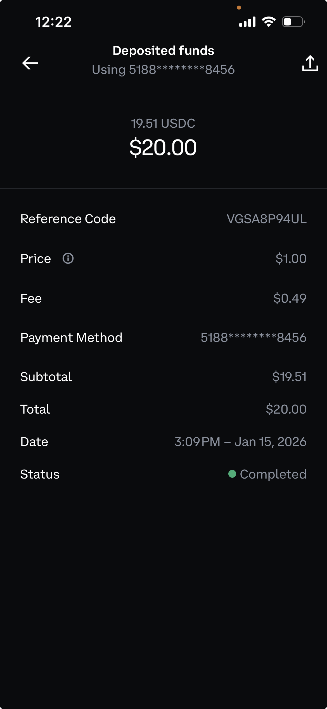
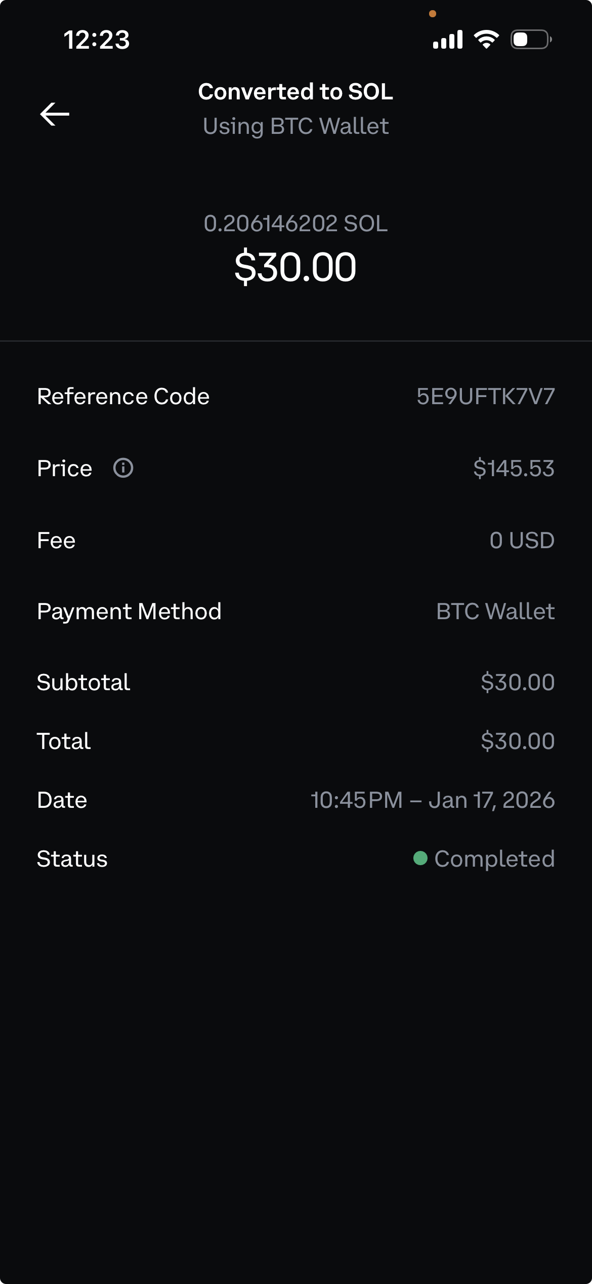
Coinbase transaction screenshots
4/17

Slide 5
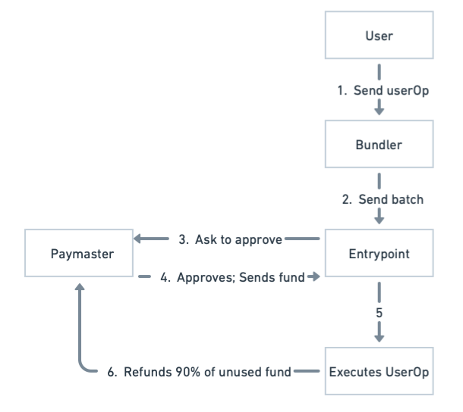
How does an ERC4337 architecture
work with Baseline Paymaster?
5/17

Slide 6
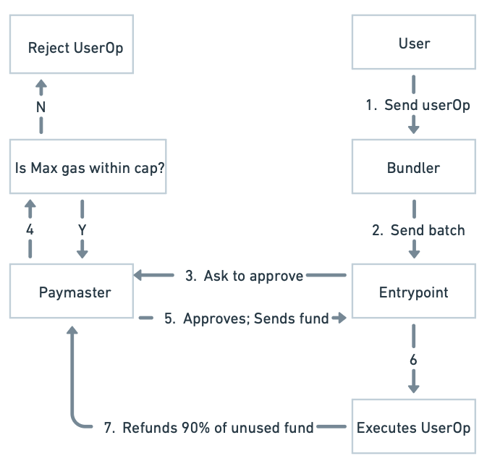
How does an ERC4337 architecture
work with Secured Paymaster
Enforcing Max Gas Cap Limit
The Paymaster enforces a strict Max Gas Limit per transaction type.
Transactions exceeding this cap are rejected during validation, preventing the Paymaster from being exposed to inflated penalty costs.
6/17

Slide 7
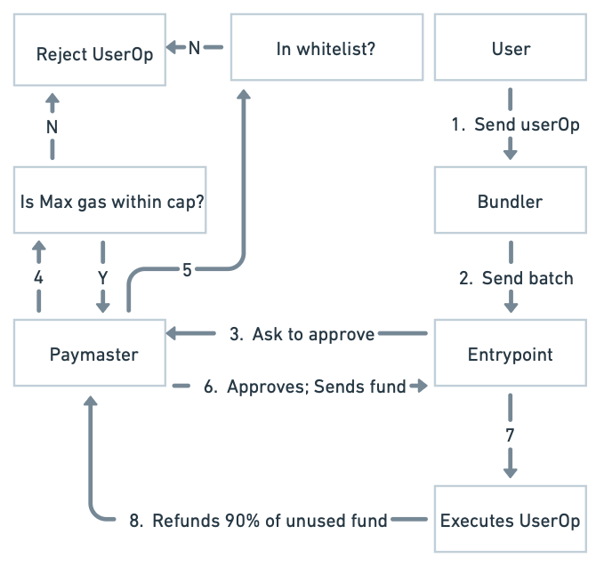
How does an ERC4337 architecture
work with Secured Paymaster
2. Target contract Whitelisting
Maintain a whitelist of allowed target contract addresses.
Blocks unauthorized dApps while still sponsoring approved operations.
7/17

Slide 8
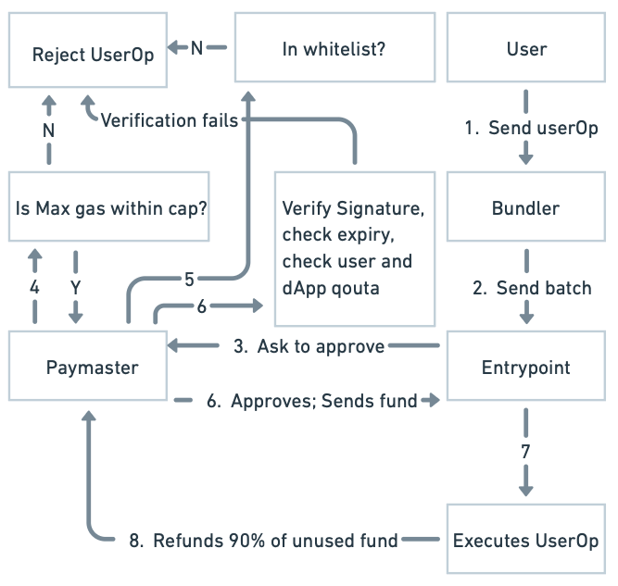
How does an ERC4337 architecture
work with Secured Paymaster
3. Quota & Rate Limiting Architecture
Strict cap (e.g., 0.01 ETH) on gas sponsorship per user address per day. Prevents individual attackers from draining the pool.
Global limits for specific applications. If a dApp is compromised, the damage is contained to its specific quota.
Signatures expire in 3 minutes. Mitigates replay attacks and limits the window for stolen signature exploitation.
8/17

Slide 9
How does an ERC4337 architecture
work with Secured Paymaster
3. Quota & Rate Limiting Architecture
Components in sponsorship signature:
paymasterAddress: 0x<SecuredPaymasterAddress>
chainId: 11155111 (Sepolia)
virtualUserId: 0x<32-byte user id
validUntil: <unix timestamp expiry>
sponsorshipNonce: <unique nonce>
sponsoredMaxCostWei: <max ETH-in-wei sponsor agrees to cover>
9/17

Slide 10
Methodology
Comparative Security Analysis
Attack Vector Testing
Gas Cost Analysis
—
Systematic injection of spam UserOps
—
Total ETH consumed during attacks
—
Gas penalty exploitation attempts
—
Cost per operation metrics
—
PostOp failure simulation
—
Penalty charges tracking
Operational Impact
—
Authorization service latency
—
False positive blocking rate
—
User experience friction analysis
10/17

Slide 11
Results Setup
Attack testing scenarios
Experiment Design
Test Cases
I ran end-to-end attack testing for both Baseline and Secured paymasters.
Two traffic mixes were tested: 80% valid / 20% malicious and 100% valid.
Metrics collected: sponsor drain, per-transaction cost, total execution time, latency, and success rate.
Case | Mix | Rows
80-10-10 | 80% valid, 10% overcap, 10% non-whitelist | 200
100% valid | All transactions valid | 200
Columns used: type, case, txn_hash, sponsor_drain_eth, txn_cost_eth, result, user_quota, dapp_quota
11/17

Slide 12
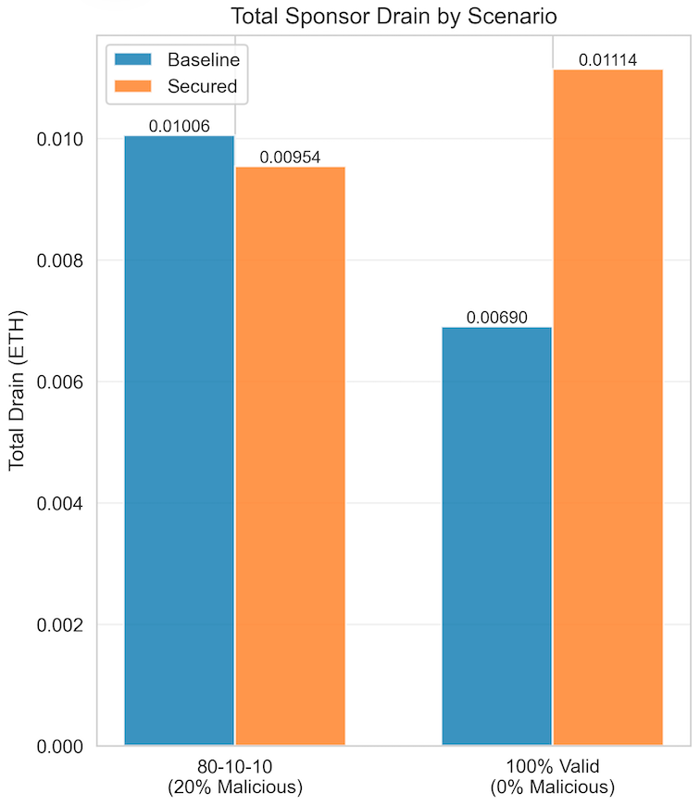
Results: Cost Analysis
Total Sponsor Drain
Case 1: 80-10-10
Baseline Paymaster:
Total drain: 0.010056 ETH
Per-txn avg: 0.000101 ETH
Secured Paymaster:
Total drain: 0.009541 ETH
Per-txn avg: 0.000095 ETH
Comparison:
Absolute savings: +0.000515 ETH
Percentage savings: +5.1%
Secured is CHEAPER ✓
Case 2: 100% valid
Baseline Paymaster:
Total drain: 0.006905 ETH
Per-txn avg: 0.000069 ETH
Secured Paymaster:
Total drain: 0.011144 ETH
Per-txn avg: 0.000111 ETH
Comparison:
Cost difference: -0.004239 ETH
Percentage difference: -61.4%
Per-txn overhead: +61.4%
Secured is MORE EXPENSIVE ✗
12/17

Slide 13
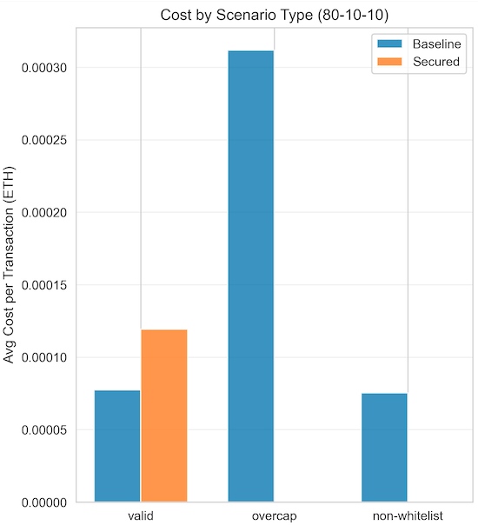
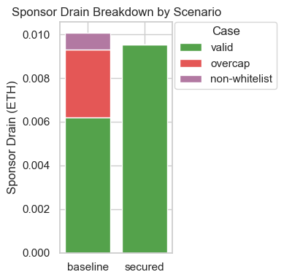
Results: Cost Analysis
Cost By Scenario Type
Per-Scenario Breakdown (80-10-10):
VALID:
Baseline avg: 0.000077 ETH (80 txns)
Secured avg: 0.000119 ETH (80 txns)
OVERCAP:
Baseline avg: 0.000312 ETH (10 txns)
Secured avg: 0.0 ETH (10 txns)
NON-WHITELIST:
Baseline avg: 0.000075 ETH (10 txns)
Secured avg: 0.0 ETH (10 txns)
13/17

Slide 14
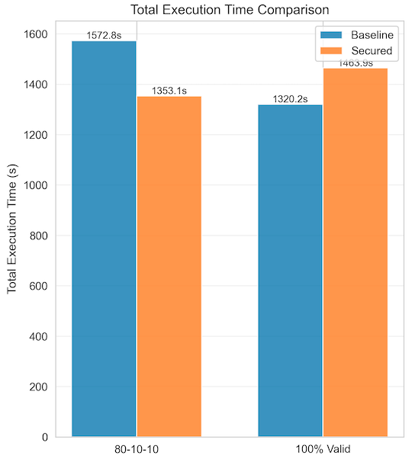
Results: Speed and Performance Analysis
Execution Time
Case 1: 80-10-10
Per-Transaction time:
• Baseline: 15.73ms per txn
• Secured: 13.53ms per txn
Speed Improvement: 14.0%
WHY SECURED IS FASTER?
Secured executes 80% of txns successfully while Baseline executes 100% of txns.
Even though validation adds overhead, fail-fast rejection of malicious txns makes secured faster overall.
Case 2: 100% valid
Per-Transaction time:
• Baseline: 13.20ms per txn
• Secured: 14.64ms per txn
Speed Penalty: 10.9% SLOWER
WHY SECURED IS SLOWER?
Validation adds latency to every txn.
No malicious txns to fast-reject.
Full cost with no benefit
14/17

Slide 15
Results: ROI
When does secure become worth the cost?
Break-even point
Decision matrix
Validation overhead per valid txn: 0.000042 ETH
Baseline valid txn cost: 0.000077 ETH
Baseline malicious txn cost: 0.000193 ETH
Secured malicious txn cost: 0.000000 ETH
Malicious traffic | Cost winner | Speed winner
0–10% | Baseline | Baseline
11–17% | Mixed / monitor | Secured starts helping
18–30% | Secured | Secured
>30% | Secured strongly | Secured strongly
Break-even malicious traffic: 17.87%
breakeven_pct = (validation_overhead / (avg_malicious_baseline_cost + validation_overhead)) * 100
15/17

Slide 16
Next Steps
Production recommendation
Recommended when
Caveats
Network malicious traffic is at or above the 18% break-even point.
Gas-cap, whitelist, and quota enforcement are required for sponsor safety.
Blocking malicious calls is more important than minimizing validation overhead.
📊 ROI CALCULATION: Assuming 100k txns/month at a savings rate of 0.0008 ETH per 100 txns (20% malicious traffic), saves you:
0.8 ETH/month which is equivalent to $1600/month
Do not use the secured path blindly in extremely clean traffic conditions.
Monitor attack rate regularly and revisit the break-even point as traffic changes.
A hybrid deployment can route known-good users to baseline and risky traffic to secured.
16/17

Slide 17
THANK YOU
Questions?
Securing ERC-4337 Paymasters Proposal
April 2026
17/17

